Slide 1

AAFT INSTITUTE
Python programming fo
r data science
Anamika Gupta
Mr.Aishwary Shukla
Submit by :
Submit to:

Slide 2
OVER VIEW
AAFT INSTITUTE
1.Pandas
2.numpy
3.matplotlib
4.plotly

Slide 3
Data structure in python
Unveiling Python's Powerhouse: Essential Data Structures
Lists (Mutable): Ordered collections of items, allowing duplicates. Can store different data types (heterogeneous). Represented by square brackets [].
Example: person = {"name": "Alice", "age": 30, "city": "New York"}. This dictionary stores information about a person.
Powerful for storing and retrieving data by key.
Example: fruits = ["apple", "banana", "orange", 10]. Here, we have strings and an integer in the same list.
Tuples (Immutable): Ordered collections of items, similar to lists but cannot be changed after creation. Represented by parentheses ().
Dictionaries (Mutable): Unordered collections of key-value pairs. Keys must be unique and immutable (often strings). Represented by curly braces {}.
Example: coordinates = (10, 20). This tuple stores x and y coordinates.
Useful for data integrity and passing arguments to functions.
Sets (Mutable): Unordered collections of unique items. No duplicates allowed. Represented by curly braces {} but with curly braces.
Example: unique_numbers = {1, 2, 2, 3, 4}. This set removes duplicates and keeps only unique numbers.
Useful for checking membership and removing duplicates.
|SODS|2024|AAFT INSTITUTE

Slide 4
ADVANCE PYTHON CONCEPT
Decorators:
Functions that modify the behavior of other functions.
Add functionality before, after, or around the original function's execution.
Commonly used for logging, timing, authorization, or error handling.
Generators:
Functions that return an iterator object, allowing for memory-efficient iteration.
Generate a sequence of values on-demand, one at a time.
Useful for processing large datasets or infinite sequences.
Metaclasses:
Classes that create other classes.
Provide dynamic control over class creation behavior.
Used for advanced object-oriented programming techniques like customizing attribute behavior.
Context Managers:
Implement the __enter__ and __exit__ methods for automatic resource management.
Ensure proper acquisition and release of resources like files or database connections.
Simplify resource management within with statements.
|SODS|2024|AAFT INSTITUTE

Slide 5
MapReduce
Map Reduced: This is likely a misspelling of "MapReduce," a programming model for processing and generating large datasets using parallel processing.
Concepts: You might be interested in learning more about specific MapReduce concepts like the Map and Reduce phases, key-value pairs, shuffle and sort, or job trackers.
filter
filter is a built-in function in Python that allows you to create an iterator containing elements from an iterable (like a list, tuple, or string) that meet a certain condition.
It takes two arguments:
A function: This function defines the condition that each element in the iterable needs to satisfy to be included in the filtered result.
An iterable: This is the sequence of elements you want to filter through.
Lambda functions
Lambda functions in Python are a concise way to define anonymous functions. They are ideal for short, single-expression functions that you use within your code.
arguments: This is a comma-separated list of arguments that the lambda function can accept. You can have zero or more arguments.
expression: This is the code that the lambda function will execute. It can be any valid Python expression that evaluates to a single value.
|SODS|2024|AAFT INSTITUTE

Slide 6
Object-Oriented Programming
Object-Oriented Programming (OOP) is a programming paradigm that revolves around objects, which are self-contained entities that encapsulate data (attributes) and related operations (methods). Here's a breakdown of three key OOP concepts related to classes: Abstraction, Polymorphism, and Encapsulation.
Abstraction:
oncept: Abstraction focuses on exposing essential details while hiding unnecessary complexity. It allows users to interact with objects without worrying about the underlying implementation details.
Imagine: A light switch. You flip the switch (interact with the object) to turn on or off the light (use its functionality) without needing to know the intricate electrical wiring (implementation details) behind the scene.
In OOP: A class acts as an abstraction, defining a blueprint for creating objects. It specifies the attributes and methods that objects of that class will have, but it hides the internal implementation details of those methods.
|SODS|2024|AAFT INSTITUTE

Slide 7
Polymorphism:
Concept: Polymorphism means "many forms." It allows objects of different classes to respond differently to the same method call. This enables flexible and reusable code.
Imagine: A remote control. You can use the same "play" button for different devices (TV, music player) even though the underlying actions to play media might differ.
In OOP: Polymorphism can be achieved through method overriding. Subclasses can inherit methods from a parent class and redefine their behavior to provide specialized functionality for the subclass. Another form of polymorphism is operator overloading, where operators like + can have different meanings depending on the object types involved.
Encapsulation:
Concept: Encapsulation refers to bundling data (attributes) and the methods that operate on that data together within a class. It restricts direct access to the data, promoting data integrity and security.
Imagine: A capsule medication. The medicine (data) is encapsulated within the capsule (class), and you access it through the intended method (opening the capsule). This protects the medicine from external tampering.
In OOP: Classes use access modifiers (public, private, protected) to control access to attributes and methods. Private members are hidden from external code, while public methods provide controlled access to the object's functionality.
|SODS|2024|AAFT INSTITUTE

Slide 8
Error handling with try-except
Error handling with try-except blocks is a fundamental mechanism in Python for managing unexpected situations that might arise during program execution. Here's a breakdown of how it works:
try Block:
The try block is where you place the code that might potentially raise an exception (error).
Python attempts to execute the statements within the try block as usual.
except Block:
The except block follows the try block and is used to handle exceptions that occur during the execution of the try block's code.
You can have one or more except blocks to handle different types of exceptions.
Each except block can optionally specify the exception type it wants to handle within parentheses (e.g., except ValueError). If no exception type is specified, it will catch any exception.
|SODS|2024|AAFT INSTITUTE

Slide 9
List comprehensions and classes
List comprehensions and classes in Python serve different purposes but can sometimes be used together to create concise and readable code. Here's a breakdown of each concept and how they might interact:
Purpose: List comprehensions offer a compact and expressive way to create new lists based on existing iterables (like lists, strings, or tuples).
Classes:
Purpose: Classes are fundamental building blocks in Object-Oriented Programming (OOP). They define blueprints for creating objects that encapsulate data (attributes) and related operations (methods).
Structure: A class typically includes:
Attribute definitions to store data within objects.
Method definitions to specify functionalities that objects can perform.
A constructor method (__init__) to initialize objects with specific attributes.
|SODS|2024|AAFT INSTITUTE

Slide 10
Pandas
Pandas is a Python library for data manipulation and analysis, offering powerful data structures like Series and DataFrame along with tools for cleaning, preparation, analysis, and integration with other data analysis libraries.
Importance of Pandas
Efficient Data Handling: Pandas provides efficient data structures like Series and DataFrame for handling structured data, making it easier to work with large datasets.
Data Cleaning and Preparation: Offers functions and methods for cleaning, transforming, and preparing data, including handling missing values and reshaping datasets.
Data Analysis: Facilitates exploratory data analysis by providing methods for grouping, aggregating, sorting, and filtering data, enabling insights into data patterns and trends.
Time Series Analysis: Supports time series data analysis with specialized functionalities for date/time indexing, resampling, and time zone handling
|SODS|2024|AAFT INSTITUTE

Slide 11
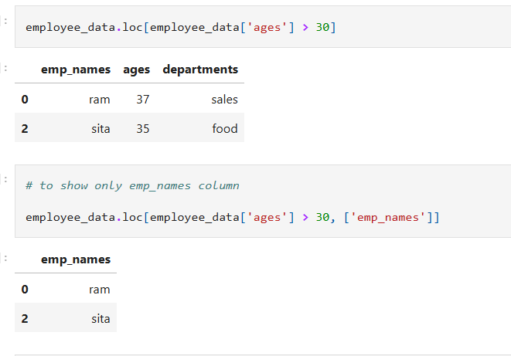
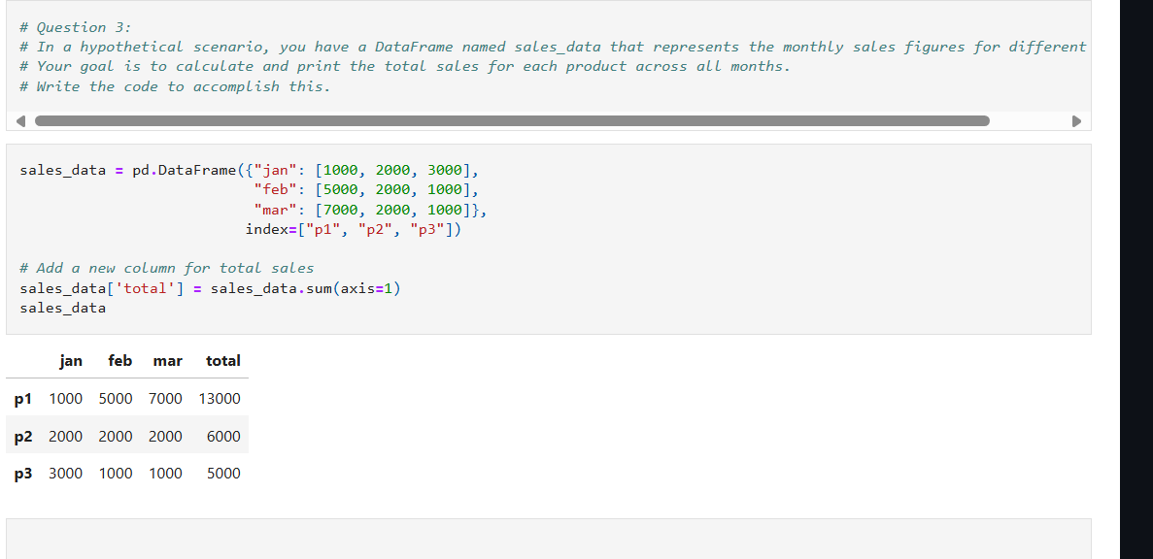
Pandas
|SODS|2024|AAFT INSTITUTE

Slide 12
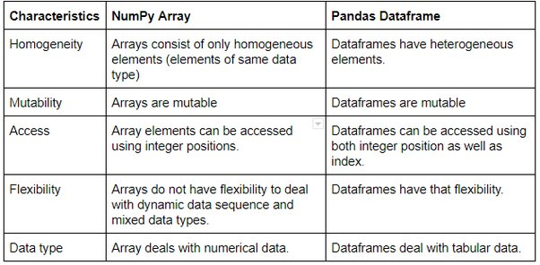
Numpy
NumPy is a Python library for numerical computing that facilitates efficient operations on arrays and matrices.
|SODS|2024|AAFT INSTITUTE

Slide 13
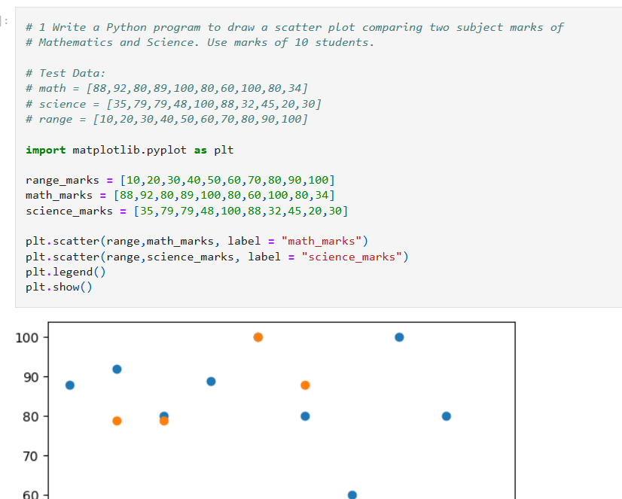
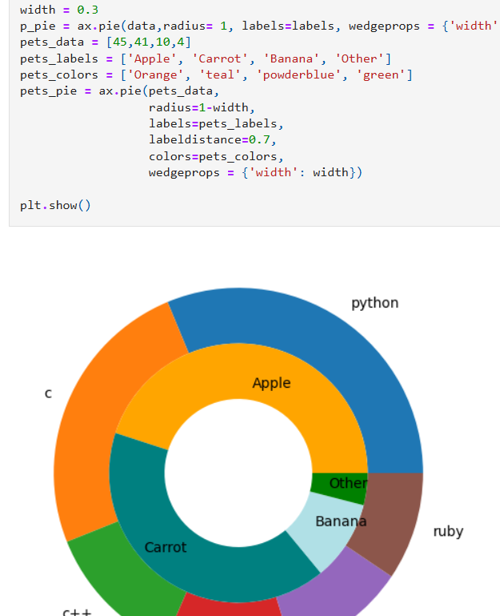
Matplotlib
Matplotlib is a low level graph plotting library in python that serves as a visualization utility.
Matplotlib was created by John D. Hunter.
Matplotlib is open source and we can use it freely.
Matplotlib is mostly written in python, a few segments are written in C, Objective-C and Javascript for Platform compatibility.
|SODS|2024|AAFT INSTITUTE

Slide 14
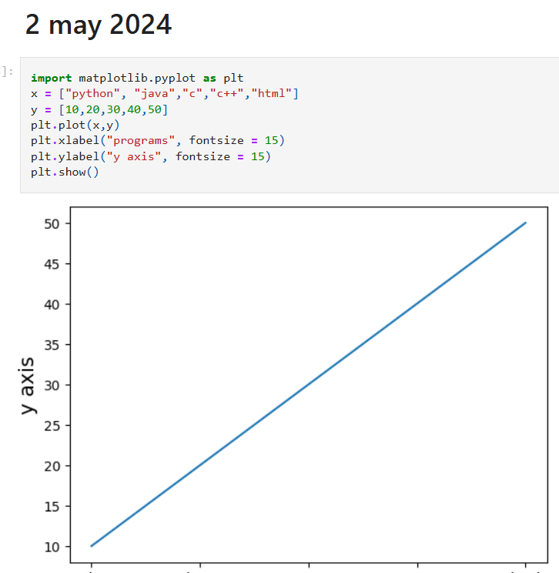
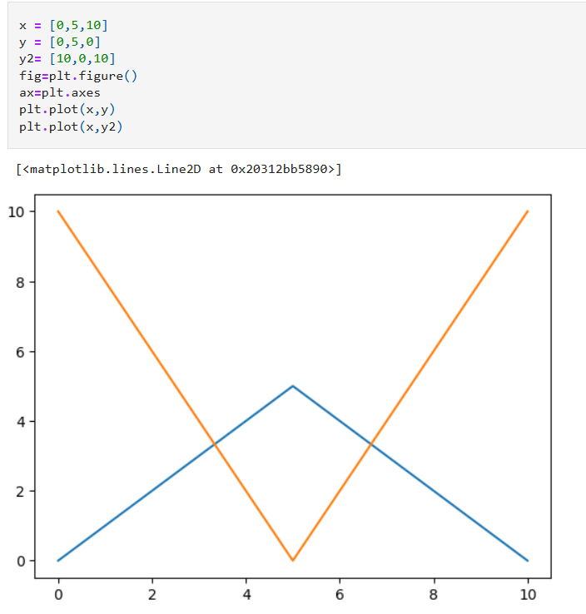
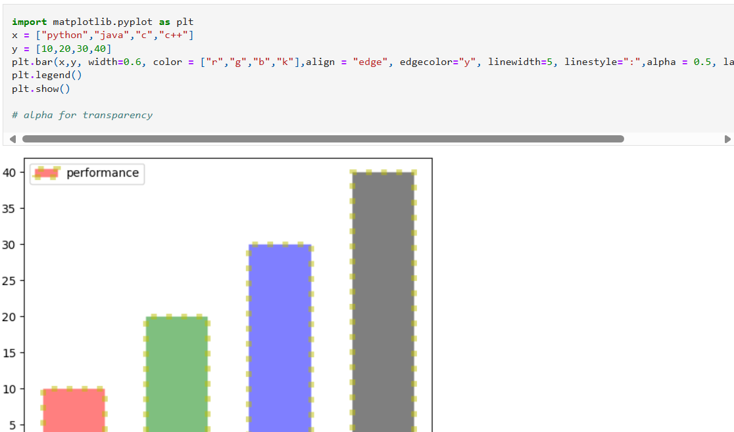
INTERACTIVE PLOTTING USING PLOTLY
Plotly is a Python library for creating interactive, publication-quality graphs and visualizations.
|SODS|2024|AAFT INSTITUTE

Slide 15
|SODS|2024|AAFT INSTITUTE

Slide 16
Thnak you for your nice attenction
|SODS|2024|AAFT INSTITUTE

